Slide 1

RISC AND CISC
ARCHITECTURE

Slide 2

CONTENT
01
WHAT IS RISC
02
RISC ARCHITECTURE
03
FEATURES OF RISC
04
WHAT IS CISC
05
CISC ARCHITECTURE
06
FEATURES OF CISC
07
DIFFERENCES

Slide 3


RISC
RISC stands for Reduced Instruction Set Computer Processor.
It is used to increase CPU performance.
It is used in portable devices due to its power efficiency.
EX:- Apple ipod.
It has a high performance over CISC.
It is using the pipelining method for execution.
RISC reduces the cycles per instruction at the cost of the number of instructions per program.

Slide 4

RISC is a microprocessor architecture that uses a simple set of instructions that can be substantially modified.
It is designed to reduce the time it takes for instructions to execute by optimizing and reducing the number of instructions.
It means that each instruction cycle has only one clock per cycle and each cycle consists of three parameters: fetch, decode and execute.
The RISC processor can also combine multiple complex instructions into a simple one.
RISC chips require several transistors, making them less expensive to develop and reducing instruction execution time.
Examples of RISC processors are PowerPC, Microchip PIC, SUN's SPARC, RISC-V.

Slide 5
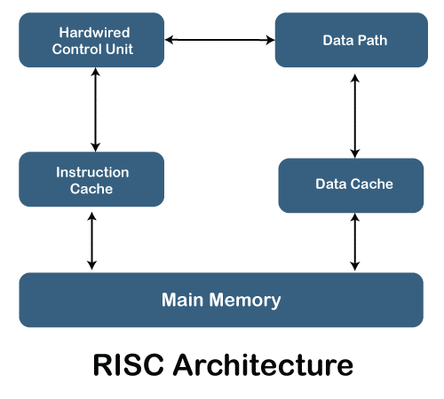
COMPONENTS OF RISC:
Main Memory :
It has two components :
1.To store instructions(programs)
2.To store Data(Operands)
Instruction cache:
It will store the frequently used instructions.
Data Cache:
It will store the frequently used data.

Slide 6
Data Path:
The Data required for execution(Operands) sent to
Hardwired control unit through data path
Hardwired Control Unit:
This is responsible for generating the control signals that are used for performing the execution of the instructions.
- It fetches the instructions from the memory and decode it.
-The operand data required for execution is fetched from the main memory through the data path

Slide 7
FEATURES
Ability to execute one instruction in one clock cycle.
RISC processors consists mostly register- to-register operations
All operations are done with in the registers of the CPU
i.e, It uses huge number of registers. It is also called as Large Register File.
All instructions will have same number of bits , therefore memory requirement is very less.
Overlapped register windows (It is technique to speed up the procedure like call & return).
RISC processors use one clock per cycle (CPI) to execute each instruction in a computer. Each CPI also comprises the methods for fetching, decoding and executing computer instructions.
RISC has a simple addressing mode and fixed instruction length for the pipeline execution.
It uses LOAD and STORE instruction to access the memory location.

Slide 8
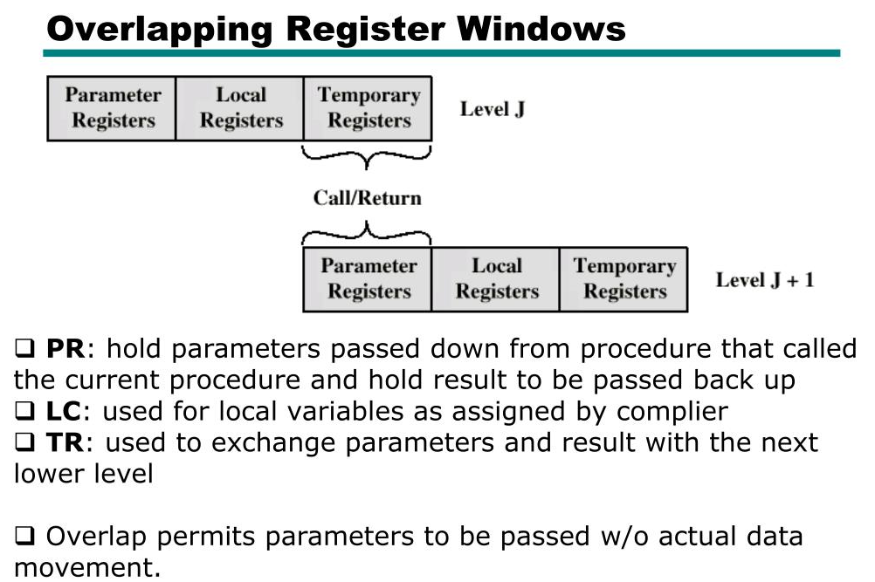

Slide 9
CISC
CISC stands for Complex Instruction Set Computer Processor.
It is also used to increase CPU performance.
CISC is designed to decrease the memory cost
CISC tries to minimize the number of instructions per program but at the cost of increasing the number of cycles per instruction.

Slide 10
Intel developed the CISC processor.
It has an extensive collection of complex instructions that range from simple to very complex and specializes in the assembly language level, which takes a long time to execute the instructions.
So, CISC approaches reducing the number of instructions on each program and ignoring the number of cycles per instruction.
It emphasizes building complex instructions directly in the hardware because the hardware is always faster than software.
However, CISC chips are relatively slower than RISC chips but use little instructions.
Examples of CISC processors are AMD, Intel x86, and the System/360.

Slide 11
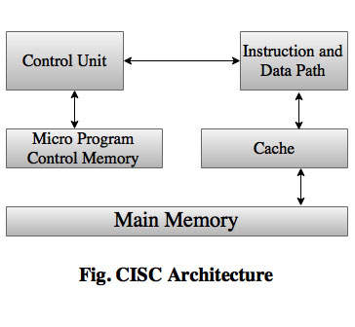
COMPONENTS OF CISC
It has two memory units namely
1.Main Memory
2.Control memory
Main Memory :
The instructions and the data required for the execution are stored in main memory.
Control Memory:
The machine instructions generate a chain of micro instructions in the control memory.

Slide 12
Micro programs:
The micro programs are a set of micro instructions that are specifying various control signals that used for executing the register micro operations.
Simply to execute various register operations we require various
control signals that control signals are stored in the form of program called micro program
Cache :
The cache stores both frequently used instructions and frequently used data.

Slide 13
Instruction and Data path :
The instructions and Data required for execution are fetched from the memory through the instruction and data path.
Control Unit :
The Micro Programs are used to execute in control unit.
It executes all instructions and generates the control signals these control signals are stored in the control memory.
--Because of the control memory instructions are executed in very slow manner.

Slide 14
FEATURES
CISC architecture uses various length instruction formats.
It supports large number of instructions about 100 to 250.
As the instructions are very complex, it takes multiple cycles to execute one instruction.
CISC may take longer time than a single clock cycle to execute the code.
The length of the code is short, so it requires minimal RAM.
It provides more accessible programming in assembly language.
It focuses on creating instructions on hardware rather than software because they are faster to develop.
It comprises fewer registers and more addressing modes, typically 5 to 20.

Slide 15
It mostly consists of Memory to Memory transfer operations therefore, most of the instructions may refer memory to manipulate operands in the memory.
It is not pipe-lined
In CISC, there are often mix of simple instructions and more complicated instructions that take longer time.
So in a pipeline there are things called hazards that can create problems for smooth pipe-lining
Single register sets i.e, less number of GPR’s are formed
into one register

Slide 16
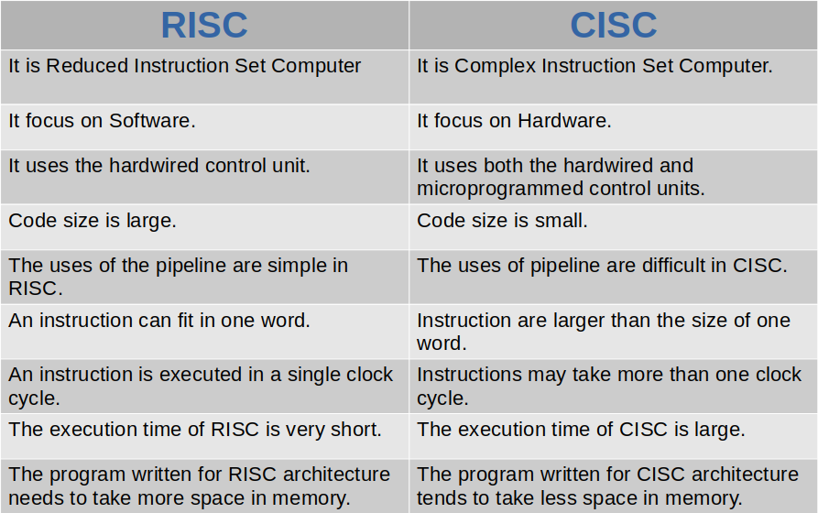
DIFFERENCES

Slide 17
THANK YOU
Harshitha Chandaka
S190987
2E/CSE

